Slide 1
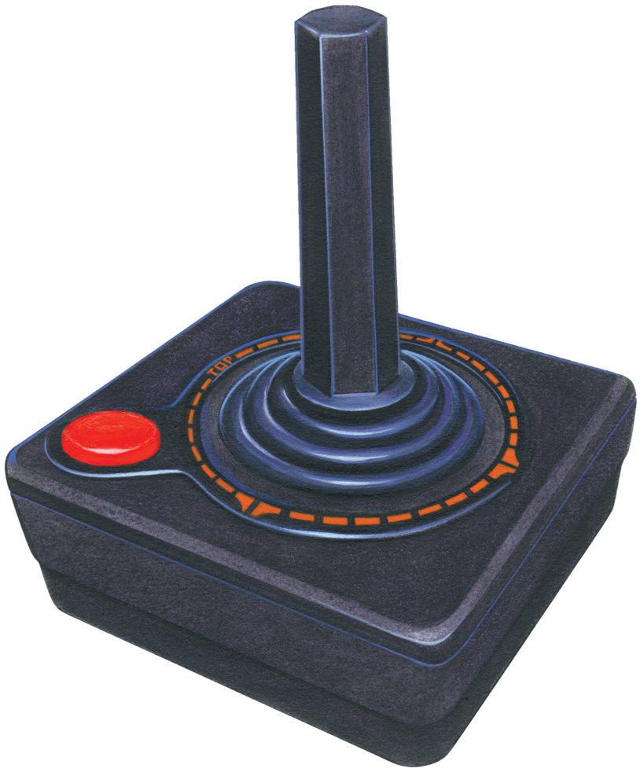
Characters Behaviors in Video game Using Reinforcement Learning

Slide 2
What is Reinforcement Learning?

Slide 3
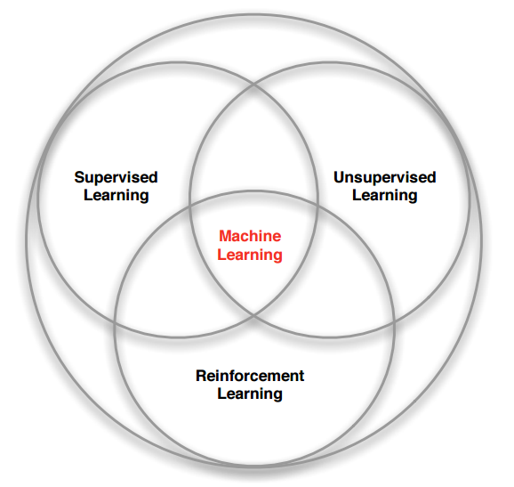
Reinforcement Learning (RL) is a one part of Machine Learning that about Trial-and-Error
That Inspire by concept of Behavioral Psychology

Slide 4
Basic Concept of Reinforcement Learning

Slide 5
Give me a hand. Good!
Give me hand. Ouch!!!!
Reward (Positive Reward)
Punishment (Negative Reward)

Slide 6
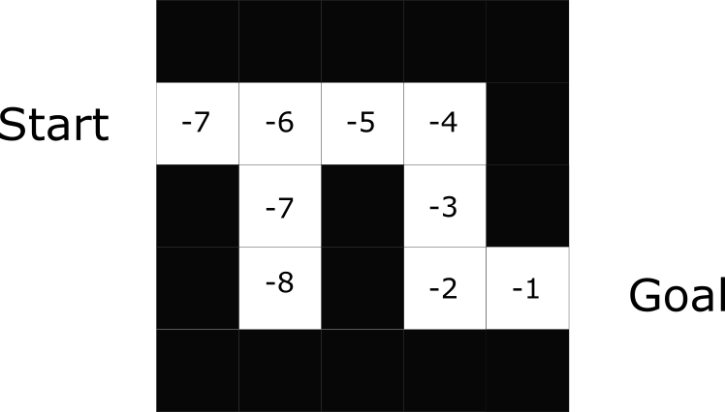
Situation : Find a Way to get out of the maze
Positive Reward : Go to Right way. You get +1 for each step
Negative Reward : Go to Wrong way. You get -1 for each step

Slide 7
Objective : Find the best way to do an optimal action to get a most reward or archieve goals

Slide 8
Reinforcement
Learning
Cycles

Slide 9
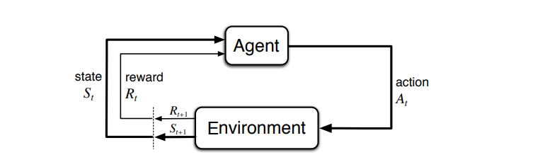

Slide 10
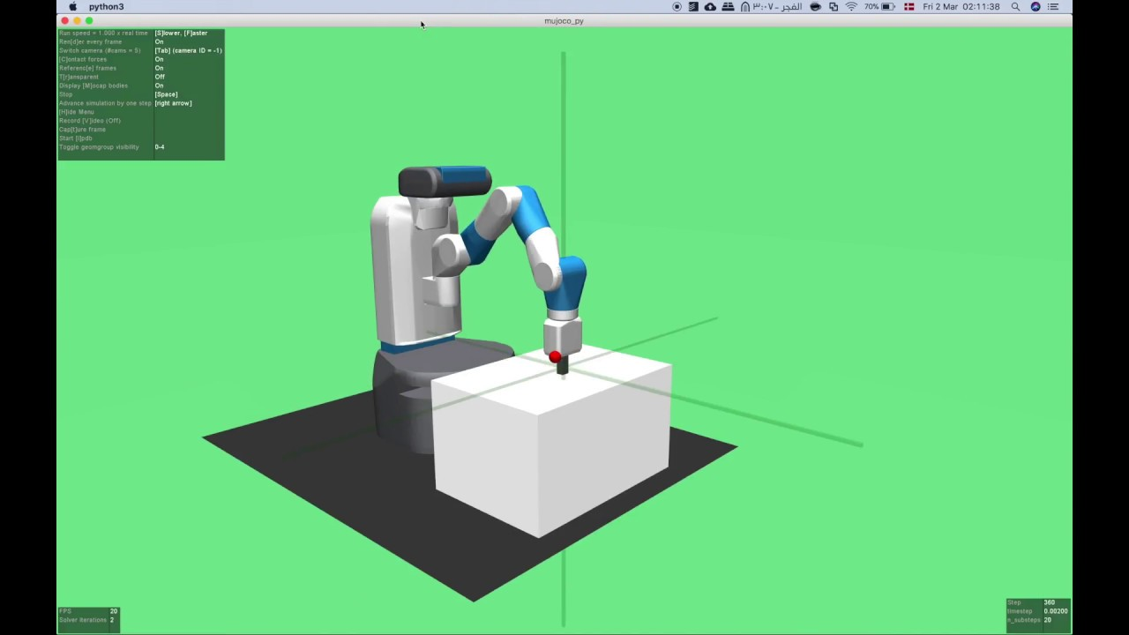
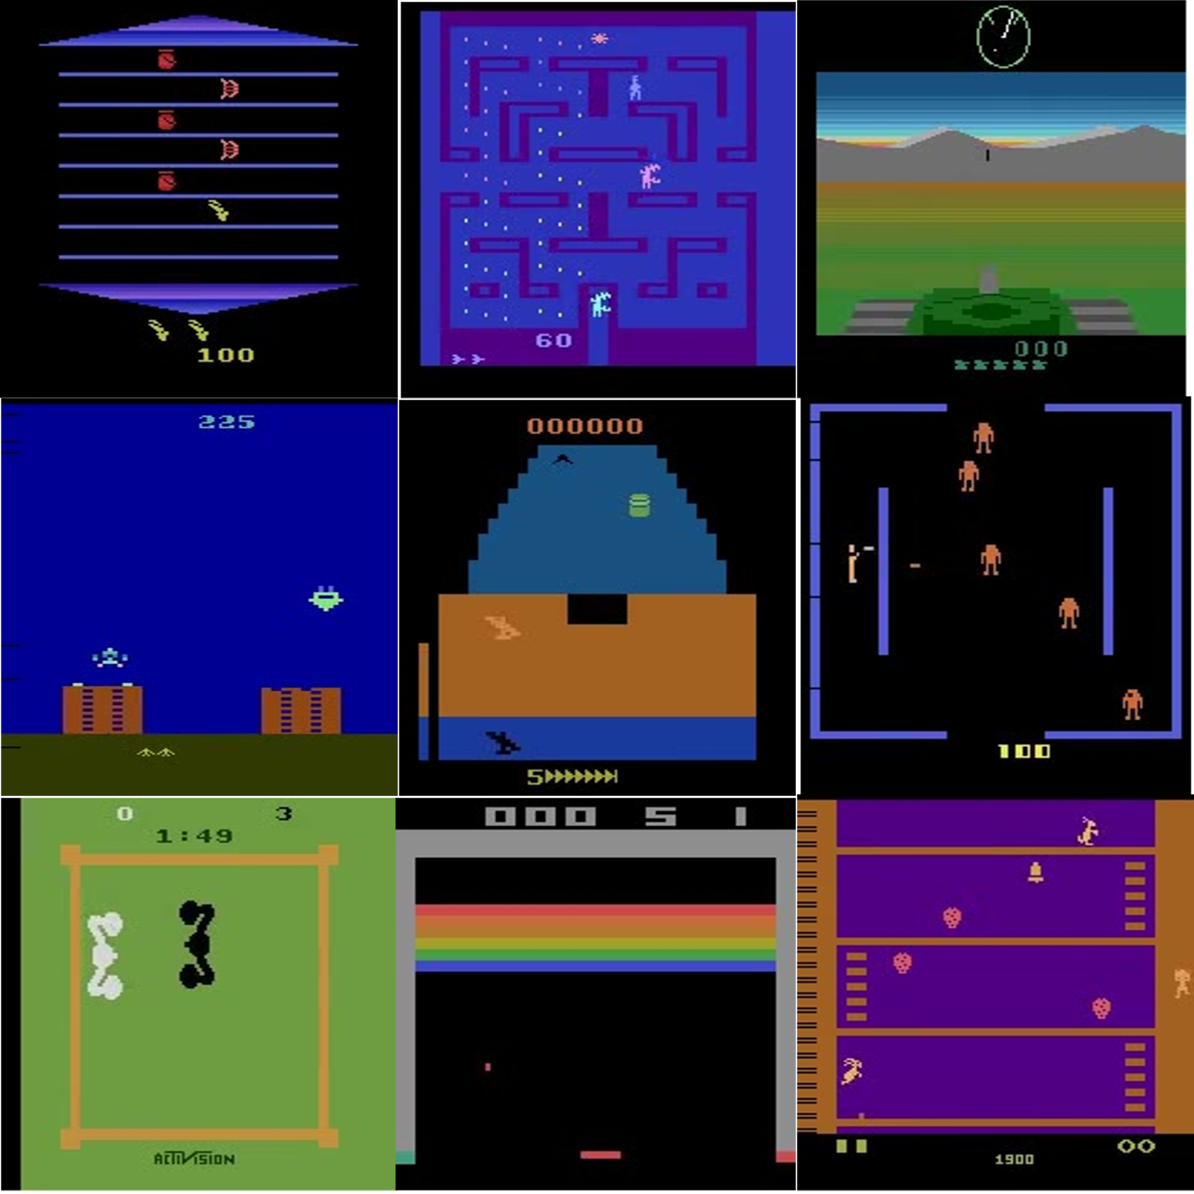
ENVIRONMENTS

Slide 11
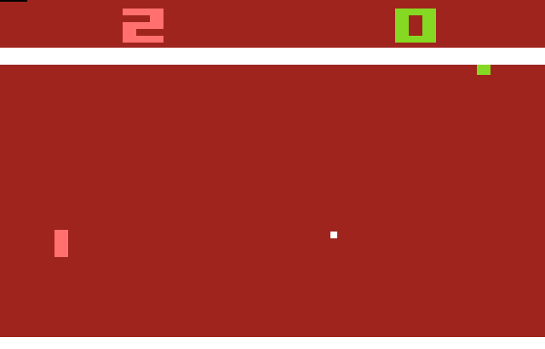

What should I do??
Agent

Slide 12
Q-Value

Slide 13
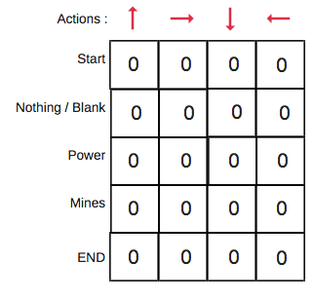
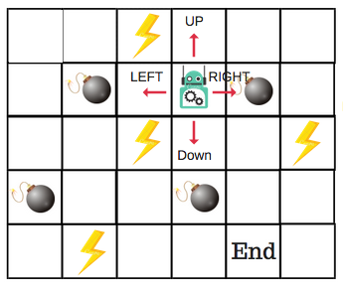


Slide 14
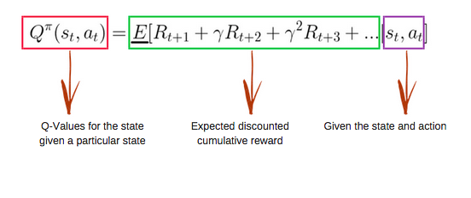

Slide 15
Deep
Reinforcement
Learning

Slide 16
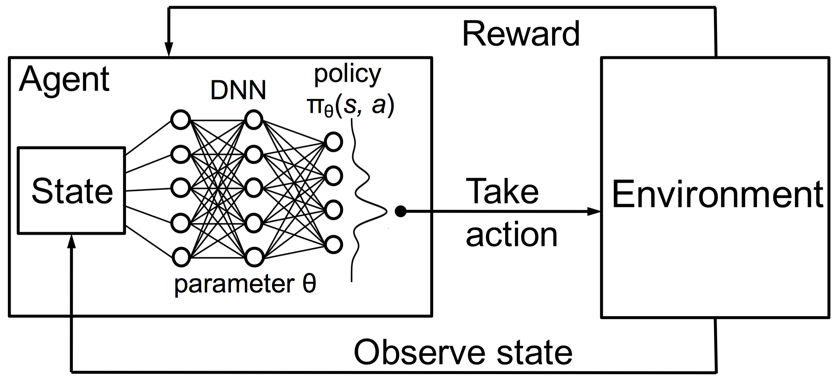

Slide 17
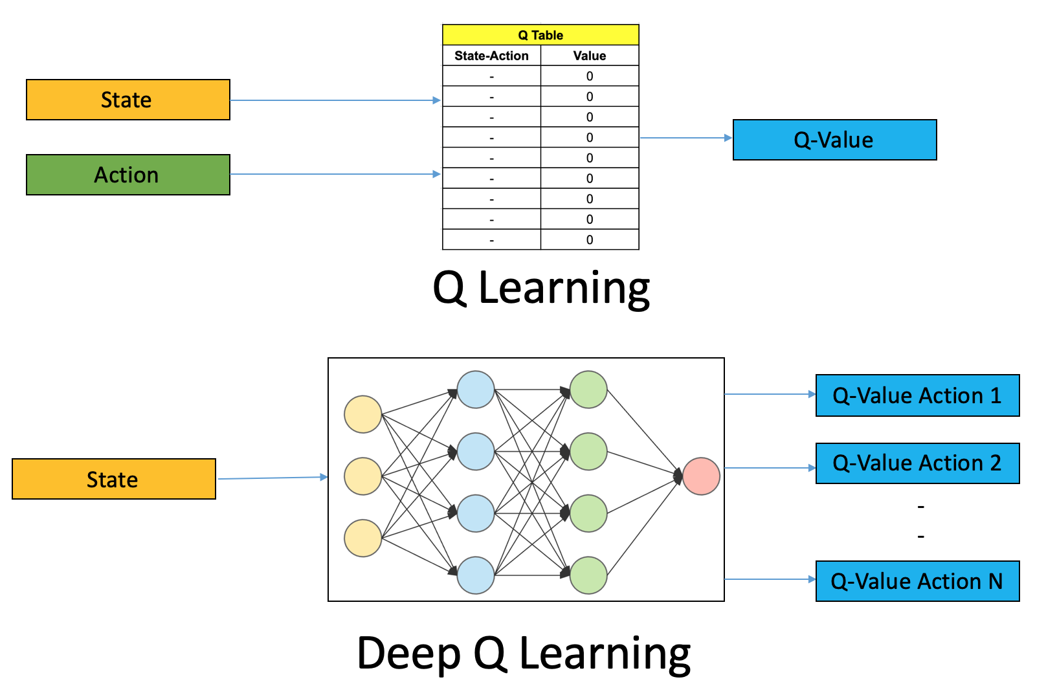

Slide 18
Reinforcement Learning Tools

Slide 19
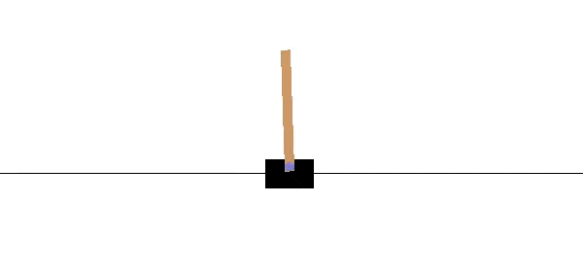
Gym : toolkit for developing and comparing reinforcement learning algorithms

Slide 20
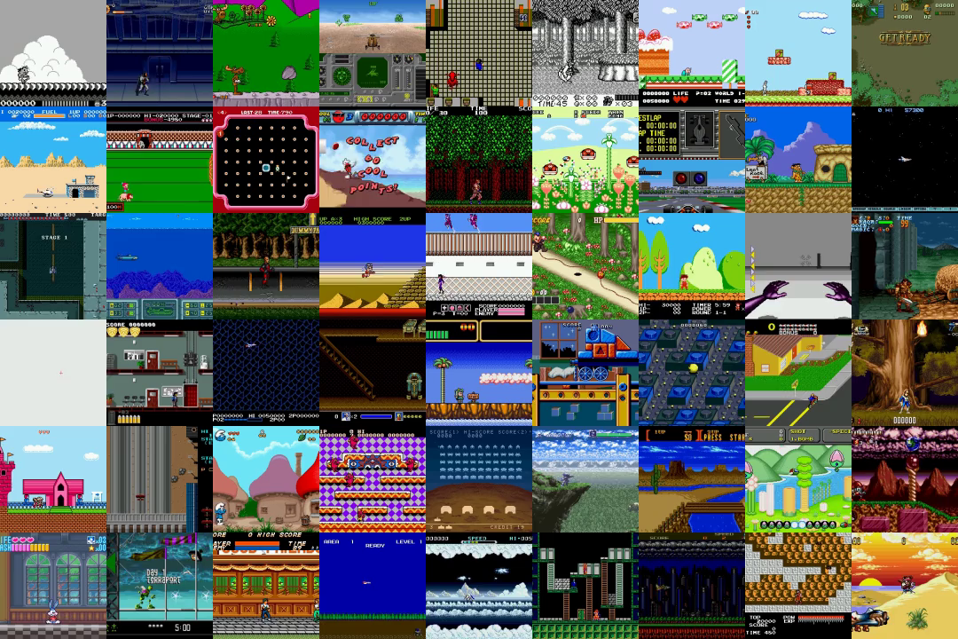
Gym Retro: turns classic video games into Gym environments for reinforcement learning

Slide 21

TensorFlow:
end-to-end open source platform for machine learnin

Slide 22
Our
Works

Slide 23
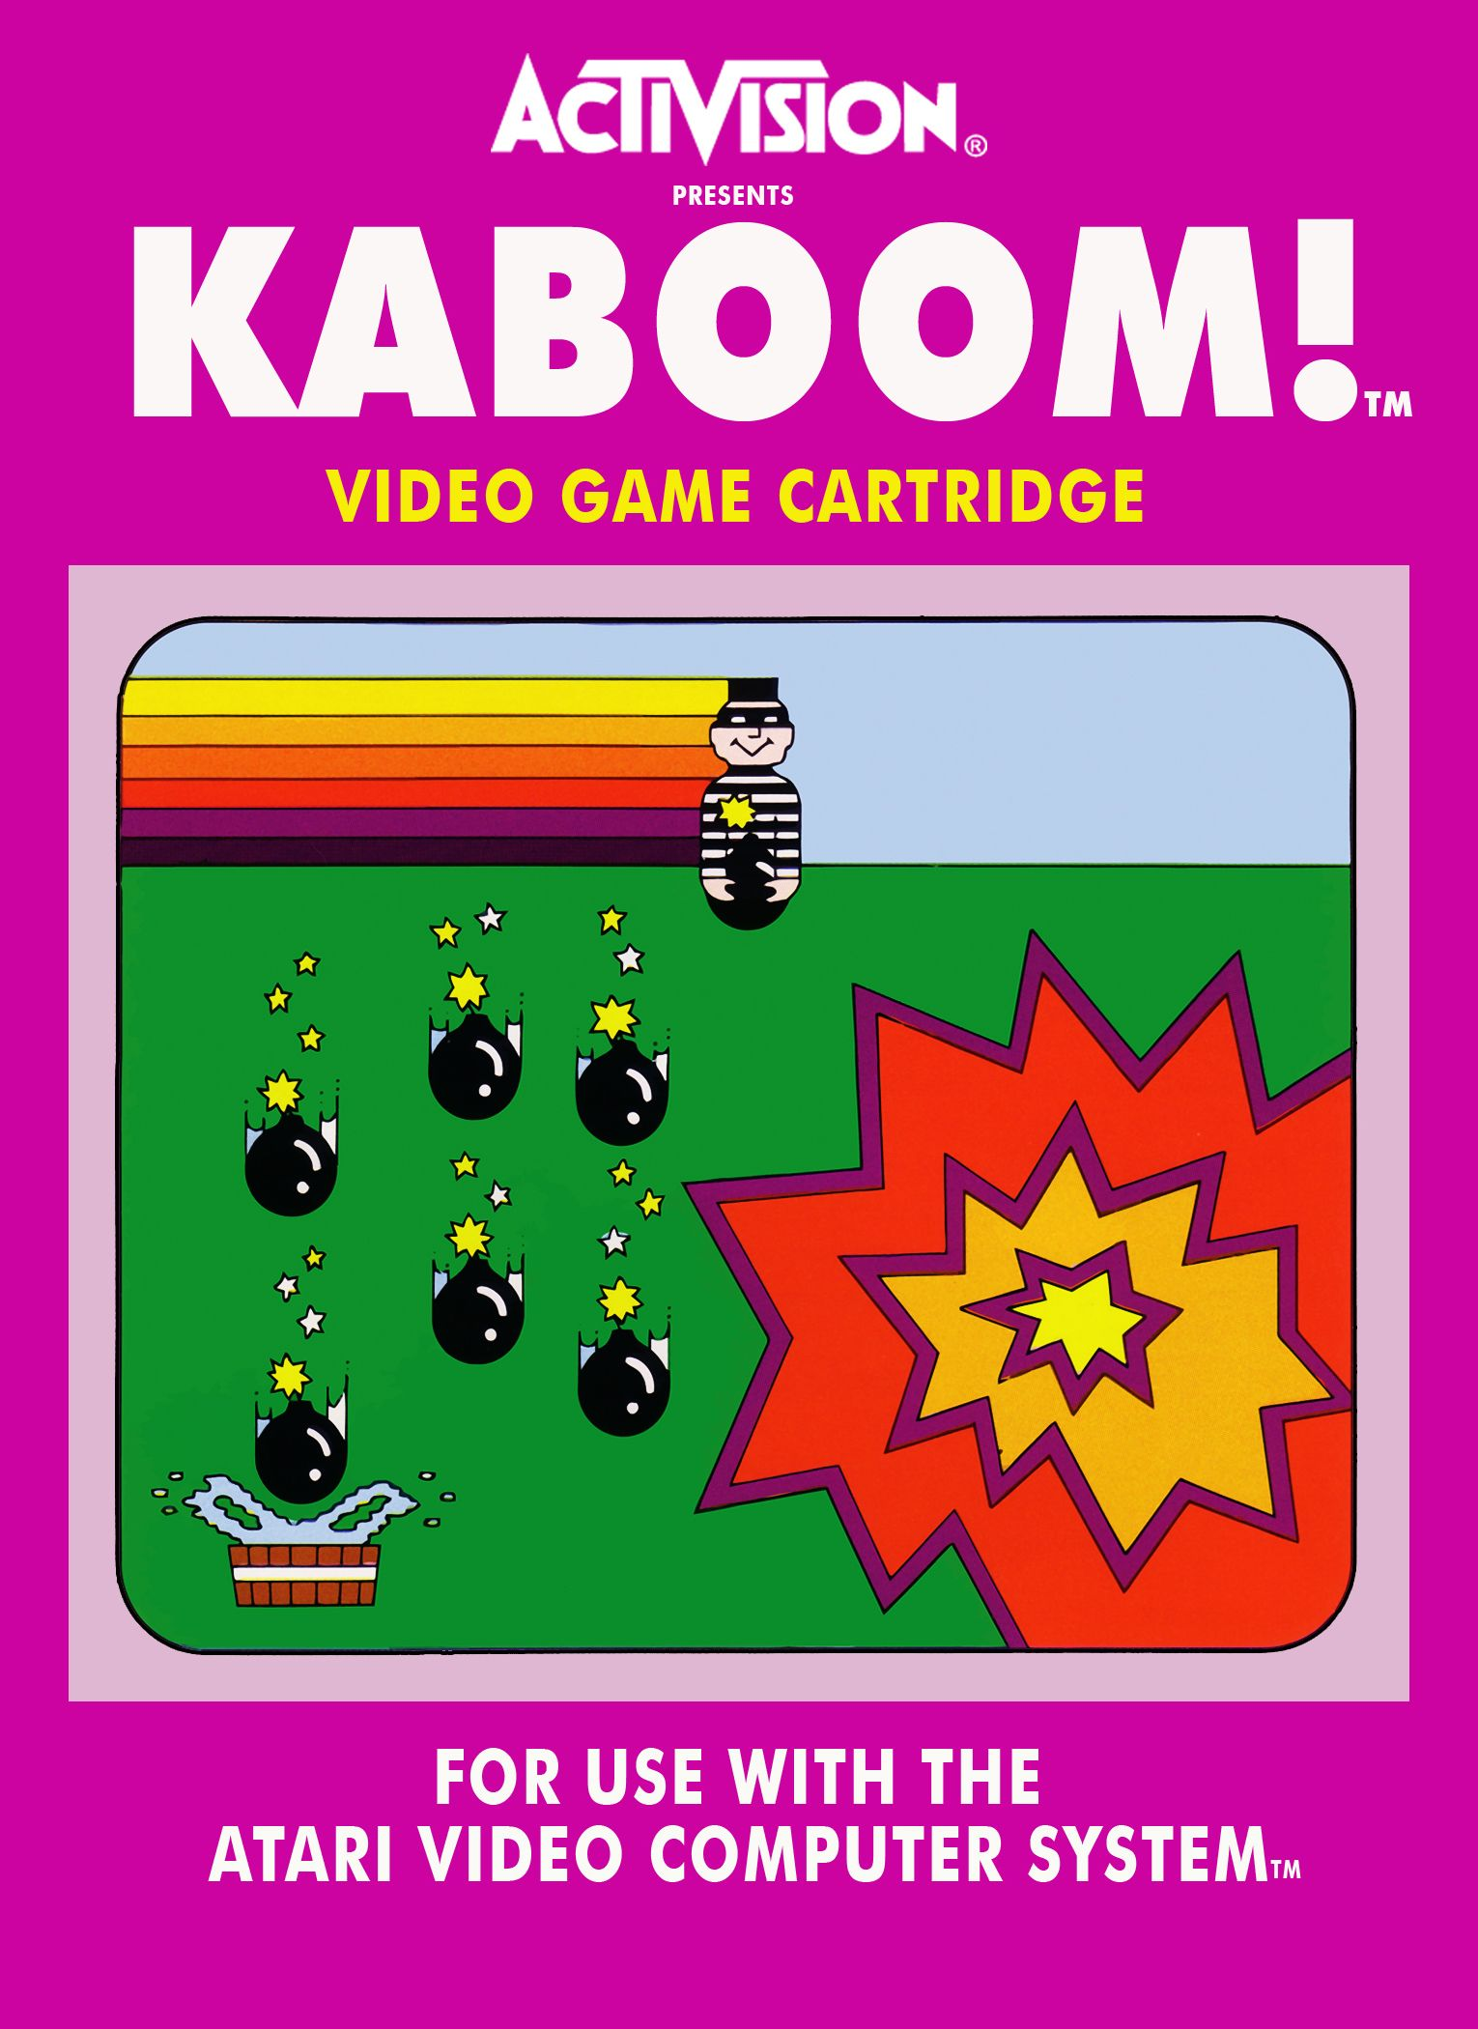
Environments
Game : Kaboom
Platform : Atari 2600
Genre : Action
Player(s) : 1 player
Deverloper : Larry Kaplan
Publisher : Activision
Objective : Received a bomb to get score

Slide 24
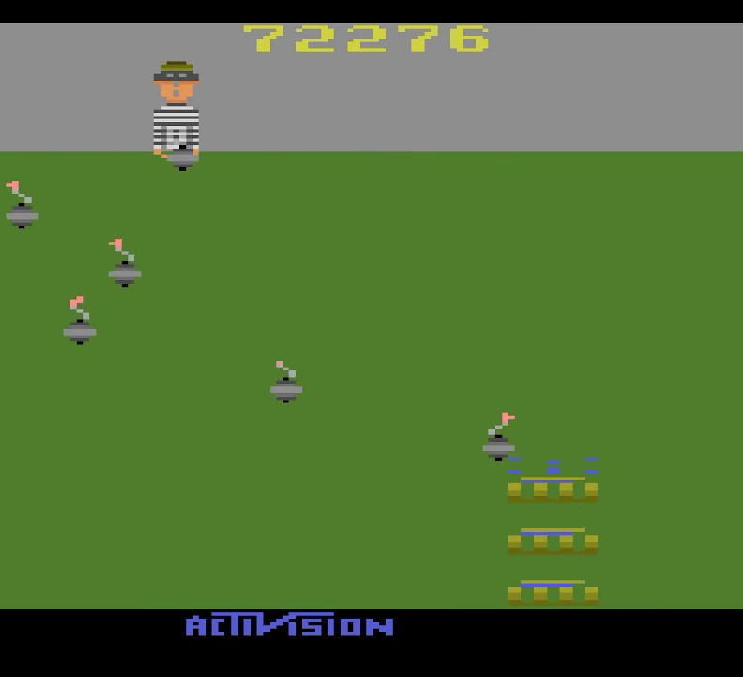
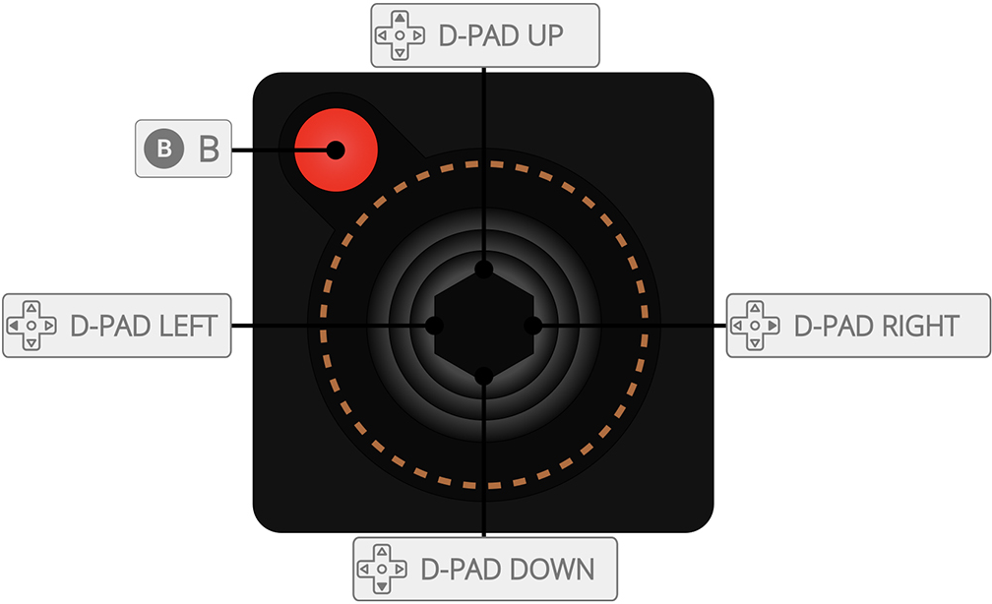
Actions
Left : Move Left
Right : Move Right
Button : Released a bomb from thief for each wave

Slide 25
Goals
Received bombs as much as possible
to get High Score, If miss lose 1 life.
If life to 0. Game Over

Slide 26
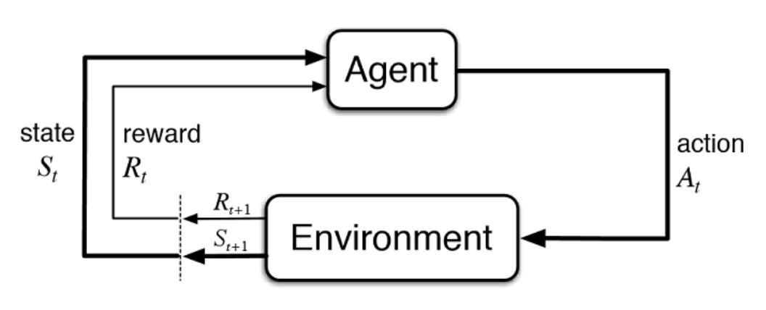
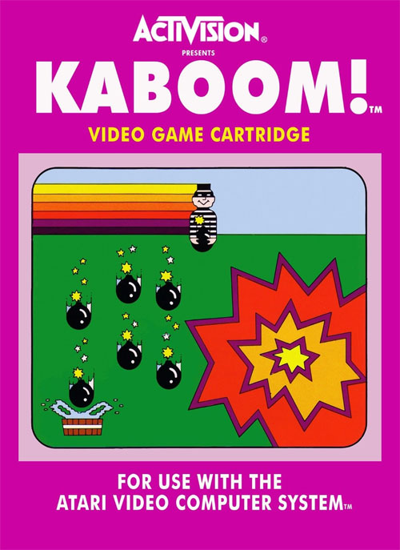
Kaboom Reinforcement Learning Cycle
State : Each Frame of Game
Action
Left, Right, Button
Environment
Kaboom Atari 2600 game
Positive Reward : if player catch a bomb. Get scores
Negative Reward : If player miss catching. Lose 1 Life

Slide 27
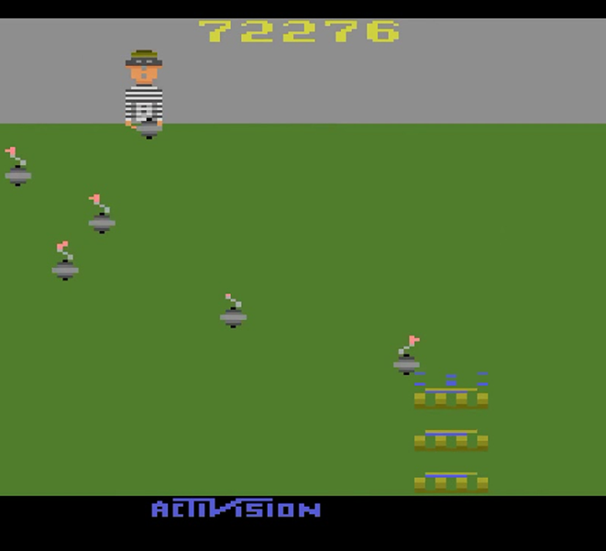
Q-Value 1 (Up)
Convolutional neural network
Q-Value 1 (Down)
Q-Value 1 (Button)
State

Slide 28
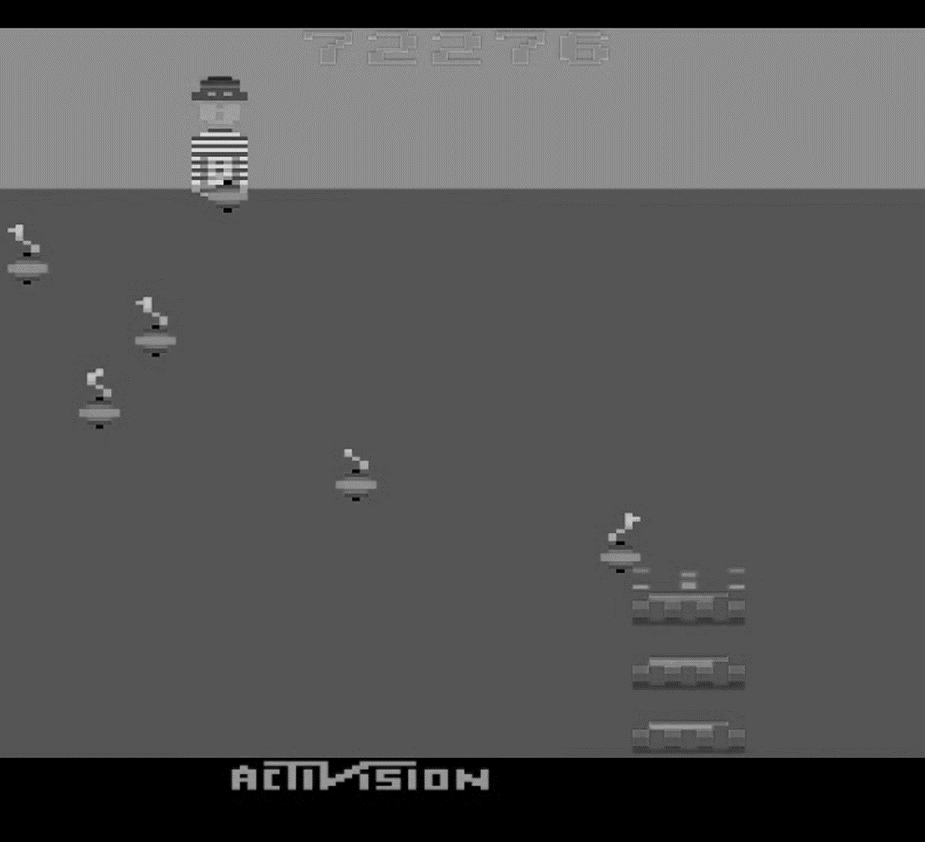

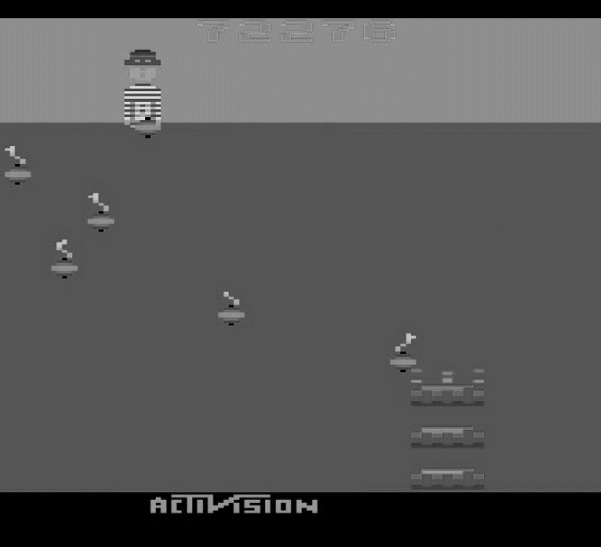
Frame Size : 210x160
Frame Size : 84x84
Turn to Grayscale
Stack to 4 frames each step

Slide 29
Double Deep
Q-Network

Slide 30
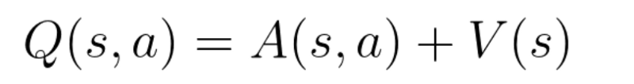
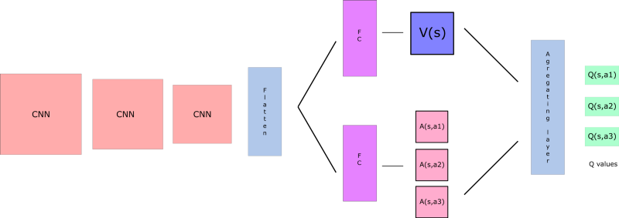
Double Deep-Q-Network (DDQN) is a upgrade version of Deep-Q-Network to fix a problem of DQN is Q-Values are overestimated that makes Agent not Find a new ways to get a optimal way to archieved objective
To fix this issue by split a State-Value Function ($V(s)$) and Advantage for each action ($A(s,a)$) and combind to find a Q-Value

Slide 31
Training Parameters
Name | Descriptions
GAMMA | Discount Factors
MEMORY SIZE | Size of storing a data
BATCH SIZE | Size of group of training
TRAINING FREQUENCY | Frequencies of training steps
TARGET NETWORK UPDATE FREQUENCY | Frequencies of updating target network
MODEL PERSISTENCE UPDATE FREQUENCY | Frequencies of saving model for training
REPLAY START SIZE | Steps of takes random action before Training
EXPLORATION MAX | Maximum value of Exploration-Exploitation Trade-off
EXPLORATION MIN | Minimum value of Exploration-Exploitation Trade-off
EXPLORATION TEST | Exploration-Exploitation Trade-off value for Testing
EXPLORATION STEP | Steps for calculate Exploration-Exploitation Trade-off decay
EXPLORATION DECAY | Rate of Decay of Exploration-Exploitation Trade-off

Slide 32
Training

Slide 33
